Slide 1

Intellectual Property Rights and Economic Development

Slide 2
Brief Outline
Introduction
Technology Transfer
IPRs and Trade
IPRs and Development (Video illustration on Patent and Economic Growth in US)
Conclusion

Slide 3

Introduction
The economic, social and cultural development through intellectual property rights is contestable issue globally
The debate on the developmental facets related to IPR has been challenged by many economists, NGOs, civil society and others, particularly in developing economies

Slide 4
Cont…
However, some argue that for developing countries, the protection of indigenous technology can be assured through conferring IPRs and is the major determinant of economic growth and poverty reduction
Moreover, this will also determine the capacity and extent to which these countries can absorb and use foreign technology

Slide 5

Introduction…
The vital question arises that, whether extending the intellectual property regime assists developing countries or not in securing the access to modern technologies provided by the developed counterpart
And also the channel through which, the protection of IPR will promote growth and development in these countries, and aid in achieving the social and economic targets
However, the effects of IPRs on the process of economic growth and development is complex

Slide 6

IP Protection Debate
Some say that stronger IP protection regime would encourage innovation and benefit developing countries by contributing to more rapid economic growth through the transfer of technology from developed to developing countries
Other argues that stronger IPR protection would neither accelerate economic growth nor facilitate rapid transfer of technology
Because, it merely, results in the transfer of economic profits to MNCs that are mostly located in the world’s most advanced economies like the US and the EU

Slide 7

IPR: Why is it Necessary?
Future of any economy largely depends on the stock of knowledge and technical advancement
Global markets demand successful marketing and variety of sophisticated products, IPR fulfills this requirement
For industrial and manufacturing growth, new technology is required
Intellectual property promotes the export of the country and others have to procure the IP based products from that country
It thus, facilitate competitiveness in industrial and commercial activity that leads to growth and development

Slide 8
IPRs Protection: Example
Korean companies developed indigenous technology with the help of intellectual property system, several of which have become global market leaders.
There has been found a strong correlation between number of patent applications in Korea and registration and real GDP during 1970-2005

Slide 9
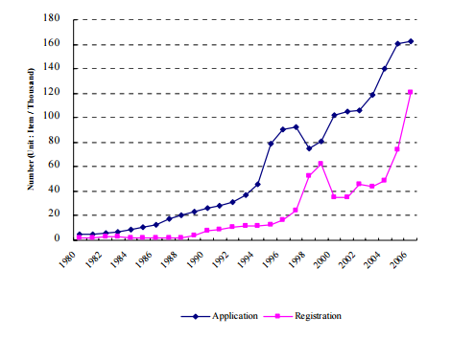
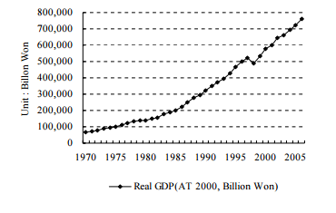
Patents and Real GDP
No. of Patent Application and Registration in Korea
Real GDP (at 2000 prices)
Source: http://www.wipo.int/export/sites/www/about-ip/en/studies/pdf/wipo_unu_07_korea.pdf

Slide 10
Challenges for Developing Countries
Greater emphasis on capacity building by mere imitation of technology through imports
Operate with imperfect knowledge and asymmetric information of technological alternatives
How the developing and the least developed economies are going to catch up with the developed economies, is unknown
IPRs are the imposition by the developed counties to the developing countries?

Slide 11

Challenges for Developing Countries…
Developed Countries- Exports High-tech sophisticated products
Developing Countries-Factor Intensive and Primary Products Exports (Natural Resources)
Developing Countries- Technology followers of the North

Slide 12

Innovation: Crucial For Economic Growth
Development as regarded by Schumpeter as the historical process of structural changes which is driven mostly by the innovation
Schumpeter called innovation as the ‘creative destruction’
And is crucial for the development
It is equally crucial for competitiveness and economic dynamism

Slide 13
Channels of Development
Through IPRs owners of the right holders seek to exploit their legal rights by turning them into commercial ventures
The possibility of attaining such advantages, in turn incentivizes innovation and creativity
However, after a certain period of time, these rights expire and then unprotected inventions and innovative works can be freely used by anyone
The developing countries can gain potentially through these inventions

Slide 14
IPRs and Technology Transfer
Transfer of technology is seen as a part of the bargaining with the developed countries by the developing countries in return of protection of IPRs in their country
TRIPS Agreement provides a number of provisions on this
For instance: rationales of safeguarding the IP is to encourage innovation and transfer of technology, which involves developed countries to offer inducements for their corporations and organizations to transfer technology to LDCs

Slide 15

Technology and Development
Technology as a factor of production-Total Factor Productivity will increase with the application of technology
Endogenous(Solow Model)
Exogenous & New Growth theories
Technology Intensity of Exports as an indicator of Technological specialization – facets of capability building

Slide 16
The Choice of Strategy and Development
Import substitution vs export promotion
Japan and the Asian Tigers, such as Hong Kong, Singapore, South Korea, and Taiwan managed to raise their per capita incomes—between 1950s to 1990s
Moreover, Thailand, Indonesia, China, and Malaysia have maintained high rate of growth for long periods- able to reduce their development gap
They all have shifted from import substitution to export promotion outward oriented developmental strategy

Slide 17
Choice of the Model
The long-run growth in the neo-classical growth models is exogenously determined
In Harrod- Domar Model- long-run growth is determined by the savings rate
The Solow Model- the long-run growth is determined by the rate of technical progress
However, these models do not explained the causes of the savings rate and rate of technological progress
Endogenous growth models attempted to remove this drawback by using microeconomics for developing the macroeconomic growth model

Slide 18

IPRs and Trade
Technology determines trade patters (Vernon’s Product Life Cycle model)
But, the level of technology is a positive function of intellectual property
Tech-intensity of exports and value capturing in global value chains depends much upon the technology
Both at the firm and national level-technology is endogenous
There is two-way relationship between technology and trade
Trade seen as a ‘highway of learning’ (Grossman and Helpman, 1994); specially under Global Value Chains (GVCs)
Further, merchandise trade itself may substantiate tech-import, via imports of sophisticated machinery and intermediates

Slide 19
IPRs and Trade...
1970 onwards witnessed the rapid increase in the commercial significance of the intellectual property rights
This was the period when intellectual property based industries and the economies as well, witnessed a rapid shift in the composition of their manufacturing exports
Again, value-added in the high-tech manufacturing as well as the value of exports increased considerably in most of the advanced economies since 1970
These advanced economies exports most sophisticated products of high-technological intensity

Slide 20
IPRs: Ethical Dilemma
Skills, talent and scientific expertise- whether they can fit into property rights regime-intangible nature
Ethical & moral questions of public domain and public interest vs IPRs protection
Pharmaceutical patents and access to medicines
Agriculture development (GM crops vs organic food)
Plant varieties protection and biodiversity
Unfair patents of traditional knowledge
Patents and farmer’s rights

Slide 21
IPRs: Ethical Dilemma…
Knowledge : Technology-Product Linkage or tradable
Market Structure necessary for Innovation -Monopolies versus competition
Right holder vested: Community versus Individual- corporate entities-Sliding balance from ‘sui generis’ to entrenched systems of Intellectual Property- strength or weakness of IPRs

Slide 22
IPRs and Development
Patent protection is crucial for the economy, since it leads to invention and commercial ventures through different contractual agreements or own venture and escalate the process of development
Trademark is a valuable asset which has significant economic importance for a firm, since it enables the firm to establish a market position, and reputation
Effective protection of trademarks thus becomes crucial for the commercial activity in any given country.
https://youtu.be/Ni3X_8SrLwM

Slide 23

IPRs and Development…
Copyright has stimulated the development of exciting local cultures, and encouraged their diffusion worldwide. For example, the international popularity of reggae, salsa, and different forms of world music.
Geographical Indications gives countries and particular regions a special status and the GI tagged product is recognized worldwide: It has huge commercial value and eventually an economy gains through GI protection

Slide 24
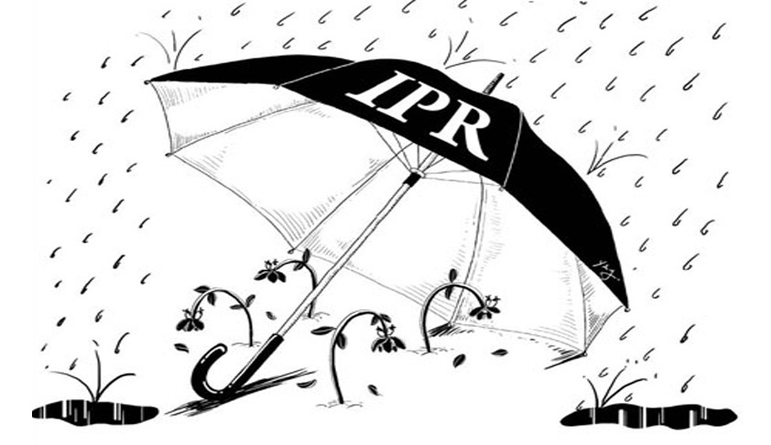
Government’s Role
Government policy to strengthen capability building in domestic firms to overcome failures in learning
Institutional Infrastructure for R&D
Policies to attract FDI that brings new technology
Technology Deepening:
      Upgrading quality and technology within existing activities.
      Moving from technologically simple to complex activities

Slide 25
Conclusion
IPRs are required for sustainable development
This is necessary because it will eventually allow countries to develop their own process of technological innovation
It enables them to absorb effectively technologies developed abroad

Slide 26
Further Readings
The Role of Intellectual Property in Development and WIPO’s Development Cooperation Program: http://www.wipo.int/export/sites/www/about-ip/en/iprm/pdf/ch3.pdf

Slide 27
Thank You

